Slide 1
Supplementary File 2

Slide 2
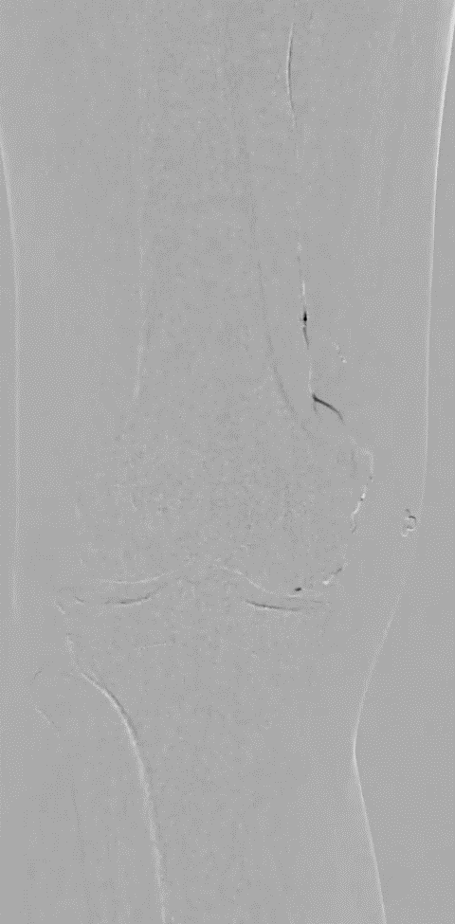
Cine angiographic images demonstrate robust anastomoses between the genicular arteries. A selective angiographic run obtained from the descending genicular artery (DGA) shows opacification of the inferior and superior genicular arteries via the DGA.

Slide 3
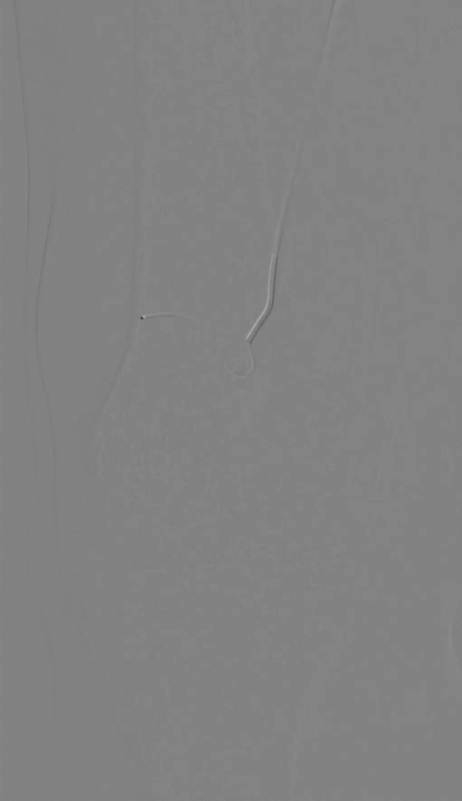

Video 1
Video 2
Cine angiographic images obtained during GAE. Video 1 demonstrates a prominent hypervascular blush arising from the superior lateral genicular artery. Video 2 shows disappearance of the hypervascular stain after initial pruning.

Slide 4
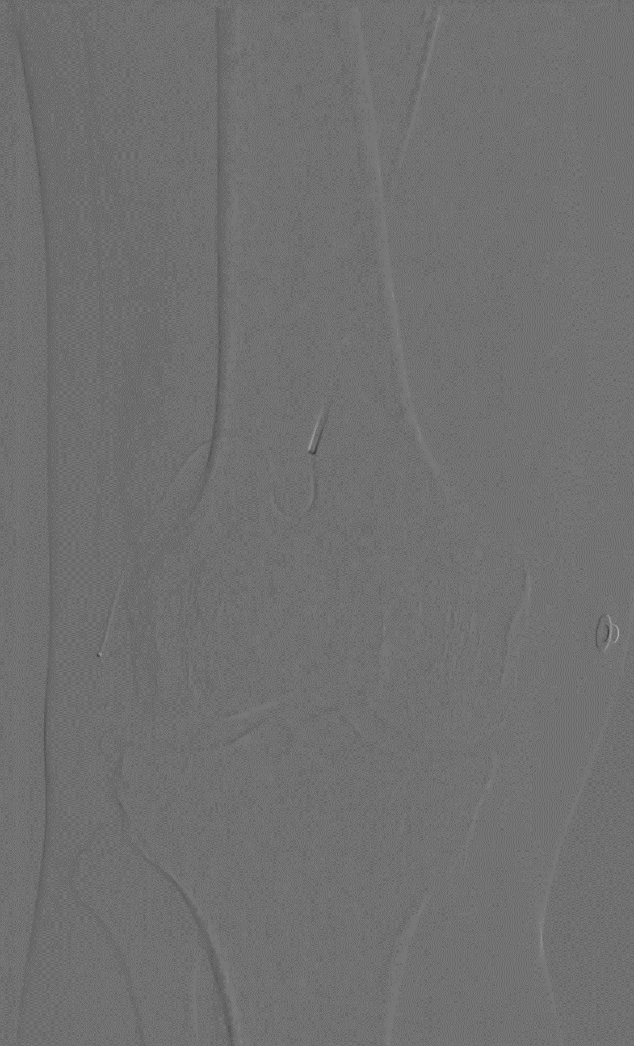
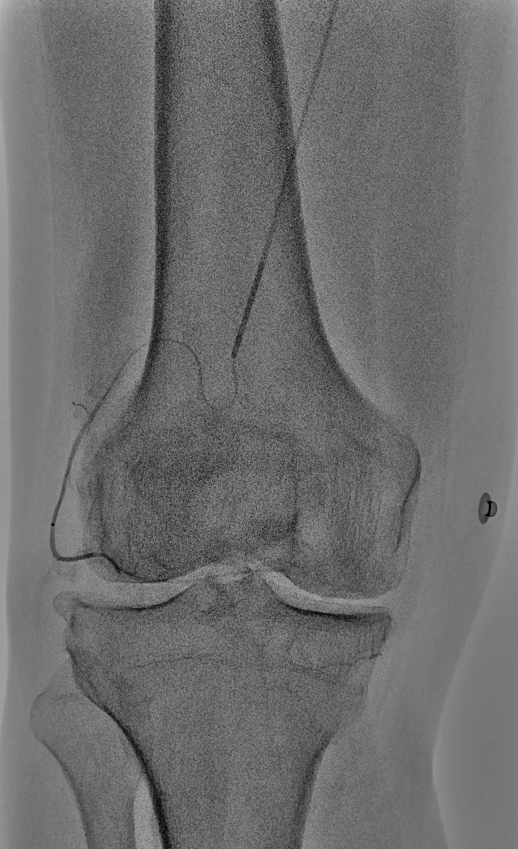
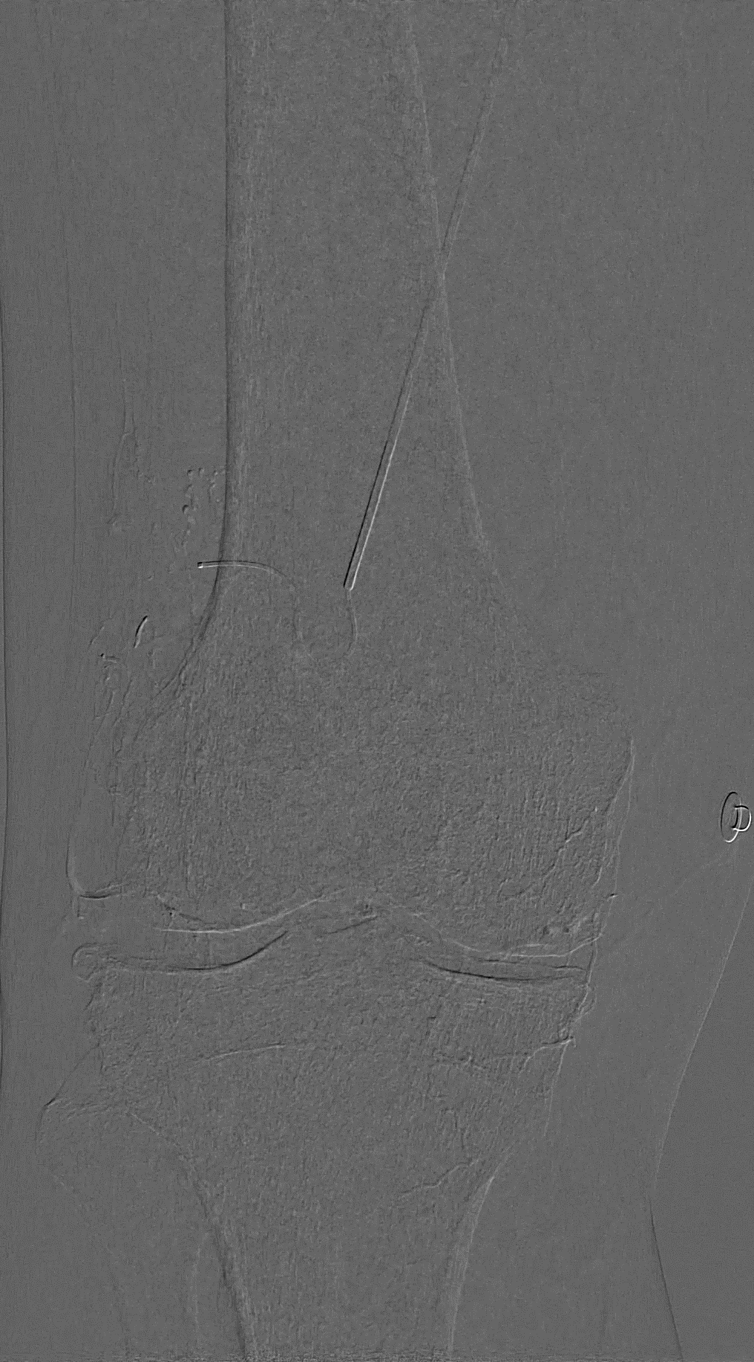
Video 3
Video 4
Video 5
After further advancement of the microcatheter into the genicular artery, repeat angiography (Video 3) demonstrates additional hypervascular blush extending toward the contralateral side despite the initial pruning, prompting further embolization and additional use of embolic agent (Video 4). Video 5 shows the final angiographic appearance after completion of embolization, with total disappearance of the hypervascular blush.

